Slide 1

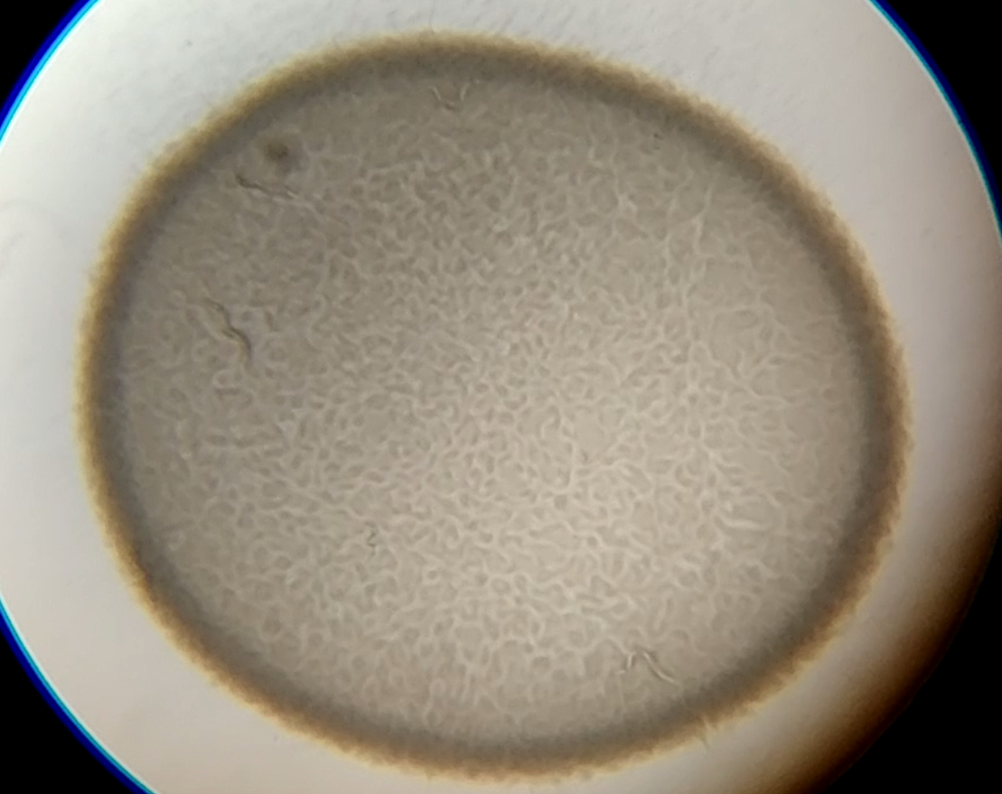
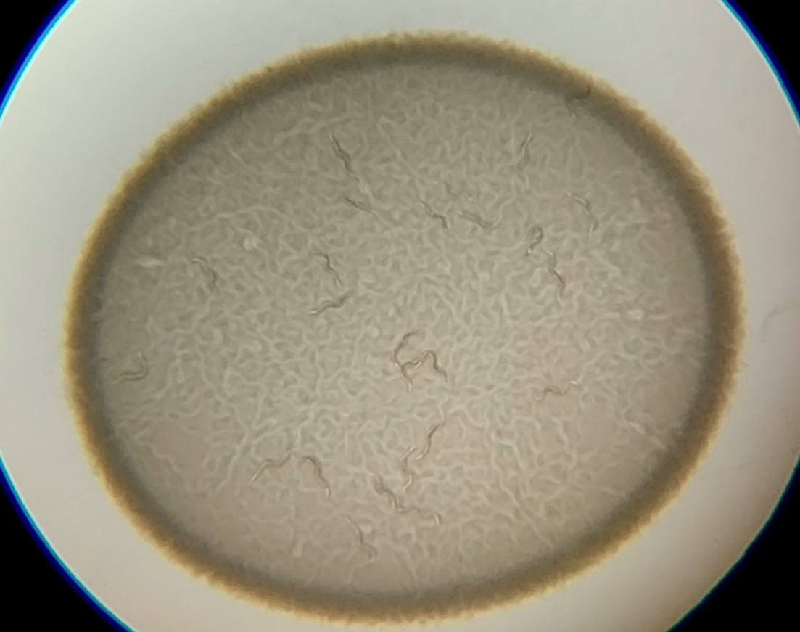
Regulation of early avoidance behavior in response to Gram-positive pathogens by tax-2 and npr-1 expressing neurons in C. elegans
Adam Filipowicz and Alejandro Aballay
Neuroscience Graduate Program, Molecular Microbiology & Immunology, Oregon Health & Science University
Abstract
Results
Conclusion
The use of C. elegans as a model for host-pathogen interactions is well established and has revealed a diverse set of sensory modalities that the worm engages in order to initiate protective behaviors including olfaction, aerotaxis, and mechanosensation. Much focus has gone into understanding the learned aversion of the initially attractive Gram-negative P. aeruginosa. Gram-positive infections, most notably with Enterococcus species, have been described in the worm, though no report on the behavioral response to these pathogens exists. Using choice assays, we observed that Enterococcus species are initially not preferred over standard E. coli OP50. Further, the worm’s behavioral response when presented with a single lawn of Enterococcus faecalis, E. faecium, or S. aureus consists of two distinct phases of avoidance: an early (1-4hr) avoidance and a late (>12hr) avoidance behavior reminiscent of the response to P. aeruginosa. The early, but not late, avoidance was found to be NPR-1 and TAX-2/4 dependent. Rescuing expression of tax-2 in specific chemosensory neurons revealed that its expression in ASE neurons, known to play a role in chemotaxis and depleted-food leaving, is crucial for early avoidance of Gram-positive pathogens. Dissecting the neural circuitry further using genetically ablated neurons suggested that a synaptic partner of ASE neurons, the olfactory AWC neurons, also play a role in this early avoidance behavior, and may govern the initial preference in the choice assay. The lack of a role for NPR-1 in the late avoidance phase is surprising given its previously described role in avoidance using P. aeruginosa but reflects how different sensory pathways are engaged in response to varying environmental situations. Overall, the relatively fast avoidance of Gram-positive bacterial species by the worm provides a useful model to uncover elements of microbial cue sensation and to elucidate how that information is integrated to initiate protective behaviors.
Food cues
Bloating
?
Odors
O₂?
?
ASE
AWC
AQR, PQR, URX?
AQR, PQR, URX?
TAX-2
TAX-2
NPR-1
NPR-1
E. faecalis is a pathogen that induces early avoidance in C. elegans. Left: Survival curves of N2 animals on different bacteria. Animals were transferred to fresh plates each day and were scored as alive, dead (no response to touch), matricidal, or missing. Right: Avoidance curves of N2 animals on the same bacteria. Animals were scored as either on or off the small bacterial lawn at the timepoints indicated and occupancy was calculated as total on/total animals. E. coli strain OP50 and P. aerugonisa strain PA14 were cultured in LB media, while E. faecalis strain OG1RF was cultured in BHI media supplemented with gentamycin. For survival assays, 50μL was spread on either slow-killing (modified NGM) or BHI+gentamycin agar plates, while for avoidance assays 20μL was spotted in the center of plates. Bacteria were allowed to grow at 37°C O/N and plates were brought to room temperature before assays were performed. All graphs represent triplicates performed on the same day.
?
?
Early pathogen avoidance
Late pathogen avoidance
Model for avoidance of E. faecalis. Food cues may be sensed by ASE and AWC neurons, along with other sensory (triangle) neurons whose activity depends on channels composed of TAX-2. These neurons synapse onto each other and also on interneurons. Separately, AQR, PQR, and URX neurons may serve as monitors of both environmental oxygen concentrations and intestinal bloating. Activity of these neurons leads to decreased avoidance behaviors and is inhibited by NPR-1. Neuronal activity may influence pathogen avoidance directly or act through interneurons (hexagon) serving as sites of sensory information integration.
Background
Early avoidance of Gram-positives is bloating independent. Left: Avoidance curves using other Gram-positive pathogens revealed a similar early avoidance phenotype. Right: RNAi against aex-5 and flr-1, two genes known to lead to bloating of the intestinal lumen due to defects in the defecation motor program, and nol-6, known to prevent colonization of the intestine by microbial pathogens, had no effect on early avoidance of E. faecalis, but did enhance or suppress the late avoidance, respectively. Avoidance assays were performed as above. RNAi was performed by feeding.
Future Directions
Olfaction
Aerotaxis
What are the cues leading to avoidance?
How are these cues sensed?
How does the internal state of the animal mediate avoidance?
How are signals integrated in coming to a decision to leave a food source?
N2
Pathogen
Avoidance
Mechano-sensation
Bloating
ASE
CO₂
BAG
O₂
tax-2(p691)
References
AQR, PQR, URX
ASI
TAX-2
TAX-2
TAX-2
Shtonda and Avery. Dietary choice behavior in Caenorhabditis elegans. J Exp Biol. 2006 Jan; 209(Pt 1): 89-102.
Meisel and Kim. Behavioral avoidance of pathogenic bacteria by Caenorhabditis elegans. Trends Immunol. 2014 Oct; 35(10): 465-70.
Yuen and Ausubel. Both live and dead Enterococci activate Caenorhabditis elegans host defense via immune and stress pathways. Virulence. 2018; 9(1): 683-699.
Couillault and Ewbank. Diverse Bacteria Are Pathogens of Caenorhabditis elegans. Infect Immun. 2002 Aug; 70(8): 4705-4707.
Milward et al. Neuronal and molecular substrates for optimal foraging in Caenorhabditis elegans. PNAS. 2011 Dec; 108(51): 20672-20677.
Singh and Aballay. Microbial Colonization Activates an Immune Fight-and-Flight Response via Neuroendocrine Signaling. Dev Cell. 2019 Apr; 49(1): 89-99.
Tran et al. C. elegans avoids toxin-producing Streptomyces using a seven transmembrane domain chemosensory receptor. eLIFE. 2017 Sep; 6: e23770.
Depleted food leaving
DAF-7
Early avoidance of E. faecalis is NPR-1 and TAX-2 dependent. Left: Animals placed on a dry plate and moving forward into a small drop of bacterial extract or buffer that has dried. The proportion of the time that animals halt movement into the dry drop is recorded. No response was observed for the extracts tested (SDS used as a positive control). Middle: Avoidance assays performed as above revealed a dependence on NPR-1 and TAX-2 at the early timepoint. Right: Snapshots of N2 and tax-2(p691) animals on E. faecalis lawns at 4hr.
AFD
ADF
RMG
NPR-1
TAX-2
OCR-2
Methods
Multiple
timepoints
Acknowledgements & Funding
Many strains were obtained from the Caenorhabditis Genetics Center. Support was provided by institutional training grants to A.F. and NIH grants 5R01AI117911 and 3R37GM070977 to A.A. I would also like to thank the members of the Aballay Lab for their comments and suggestions on experiments, and numerous helpful discussions.
1hr
Avoidance depends on ASE and AWC neurons. Left: tax-2 expression was rescued in individual neurons using cell-specific promoters. Rescue in ASE neurons restored normal avoidance. Middle: Individual neurons were genetically ablated and avoidance was tested as above. Ablating AWC neurons abrogated avoidance. Right: Performing a four quadrant choice assay (see schematic in left column) revealed that animals prefer E. coli OP50 over E. faecalis OG1RF and that ablating AWC neurons somewhat diminished this preference. Choice index = (# on E. coli - # on E. faecalis) / Total #.
E. coli
E. faecalis
See figure legends for detailed explanations.

